Slide 1
Persuasion in science journalism
Matthew hutson
The University of Minnesota 10/13/17
Notes:
-persuasion in journalism
-persuasion based on psych research
-science not not politics or law reporter, so no Ferguson, but science plays role in political debate

Slide 2
Science -> $\text{policy}$
• Psychology of prejudice, neuroscience of reaction times, biology of “race” -> Police shooting
• • •
• Climate science ->
Energy policy, zoning laws, taxation
• Biology ->
Reproduction, vaccination, GMOs
• Brain and behavioral sciences ->
Education, punishment, drug legalization
• Technology ->
Privacy, traffic safety, labor policy

Slide 3
Persuade?
Nah.
Explain
&
Engage
Notes:
Not prove something true.
Evidence and counterevidence.
Instead of persuaded, informed and interested.

Slide 4
OCEAN
• Origin:
“What initially interested you in this topic?”
• Counterintuitiveness:
“What did you find most surprising?”
• Examples:
“Any anecdotes from the news or your life?”
• Advice:
“Do you have any advice for the reader?”
• Next steps:
“What are the next steps in this research?”
Notes:
Not just what and how but story. Ask or answer.
Origin: Passions, contagious. Autobio. Context.
Counterintuitive: Heart of study. But reproducibility.
Examples: Less abstract. Applies to world. Humanize.
David Pizarro, Michael Dukakis
Advice: Psych useful.
Next: Open questions. Caveats, inspire excitement.

Slide 5
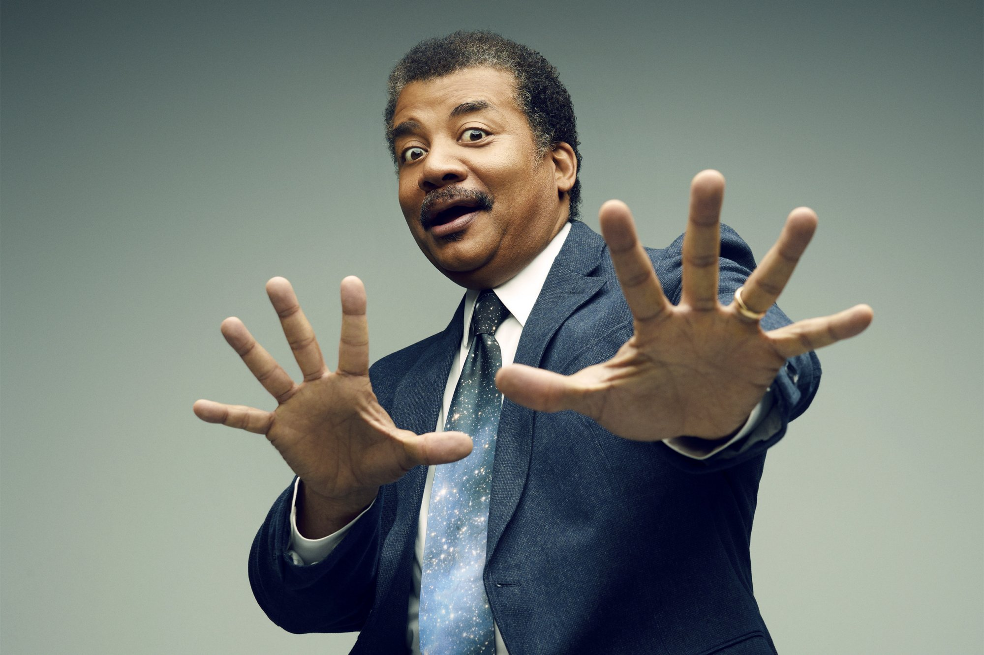
Charisma
Notes:
-Communicators charismatic. Neil deGrasse Tyson, Mary Roach
-Get ideas across.

Slide 6
Charisma
VERBAL
• Metaphors
• Stories and anecdotes
(• Moral conviction
• High expectations
• Confidence)
NONVERBAL
• Gestures
• Facial expressions
• Variance in tone of voice
(Antonakis, Fenley & Liechti, 2011)
Notes:
-Research on charisma; can learn. 8 tactics.
-Writing: Write conversationally. Read aloud.

Slide 7
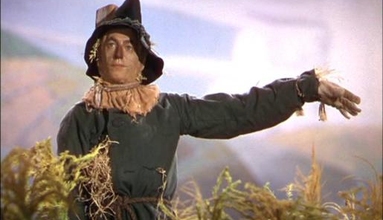
The surprising new science of straw
Notes:
-Overhype. Clicks or sales. Surprising new science of X.
-Gladwell great storyteller but sets you up. Called master of counterintuitive, but Blink intuition, Outliers luck and hard work.
-Risk losing trust.

Slide 8
AMAZON REVIEWS of “the 7 laws of magical thinking”
• “You would need a PhD. to understand what the author is writing about.”
• “Obviously Matt isn’t too bright.”
• “the author’s humor is painfully cheesy”
• “a bit long and dry.”
• “like a machine gun of little tidbits of scientific research.”
• “without enough information on actual studies done.”
Notes:
Too intellectual
Too many jokes
Too many studies
If at a loss for whom to target, target yourself minus the expertise. At least then voice authentic.

Slide 9
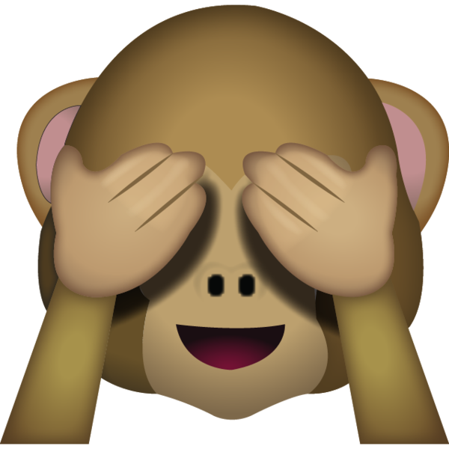
Policy -> $\text{Science}$
Notes:
Political attitudes affect views on science.
Motivated reasoning.
We believe what we want.

Slide 10
Policy -> $\text{Science}$
Motivated reasoning affects views on:
• Climate change ->
Is it real and caused by humans?
• Death penalty ->
Does it deter crime?
• Contraceptives in sex ed ->
Does it reduce teen pregnancy, STDs?
• Forceful interrogation ->
Does it produce intel?
• Stem cell research ->
Does it lead to cures?
(Campbell & Kay, 2014; Liu & Ditto, 2013)
Notes:
Attitudes -> objective costs and benefits.
Don’t recite facts. Don’t deny human nature and call people stupid or ignorant.
Make medicine easier to swallow. Palatable solutions. Regulatory and free market solutions.

Slide 11
He’s baaaaack….
Notes:
-another way to avoid alientating

Slide 12
STEELMANning
You should attempt to re-express your target’s position so clearly, vividly, and fairly that your target says, “Thanks, I wish I’d thought of putting it that way.”
You should list any points of agreement (especially if they are not matters of general or widespread agreement).
You should mention anything you have learned from your target.
Only then are you permitted to say so much as a word of rebuttal or criticism.
—Anatol Rapaport via Daniel Dennett
Notes:
Give respect to get respect.

Slide 13
$\text{Science}$ <-> policy
Notes:
Science and politics integrated. Both rely on evidence and opinion.
Persuade, educate, engage -> understand frustratingly and inspiringly irrational people are.

Slide 14
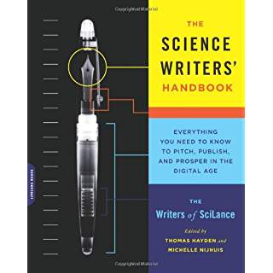
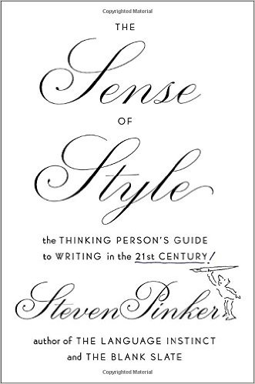
Books for science writers
A Field Guide for Science Writers (Blum, Knudson, Henig)
The Science Writers' Handbook (SciLance)
Ideas into Words (Hancock)
The Sense of Style (Pinker)

